Slide 1

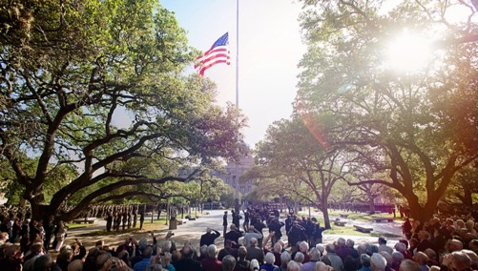

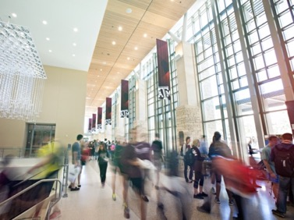
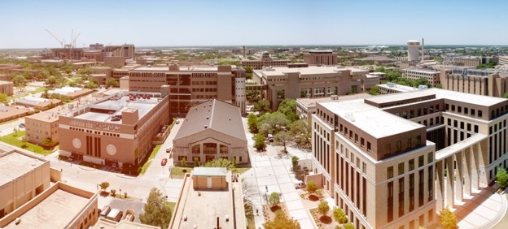
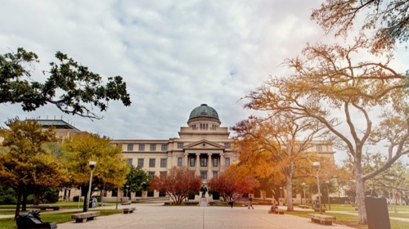
TIME SERIES Forecasting OF STOCK MARKET
SJIET
ELAVUR
PRESENTED BY:
ELAVARASAN.S
v

Slide 2
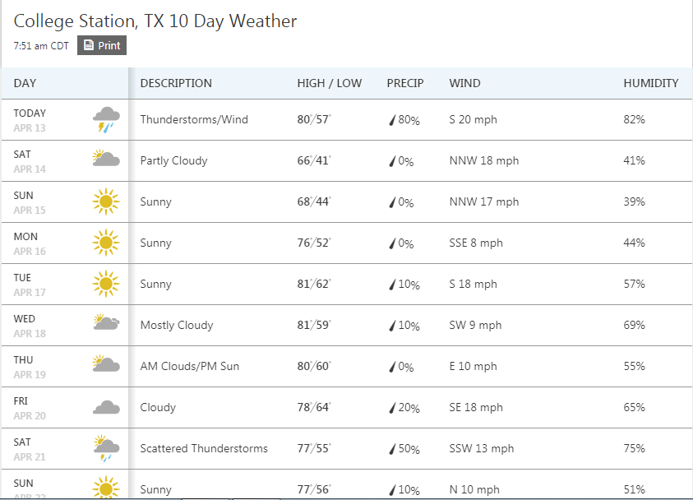
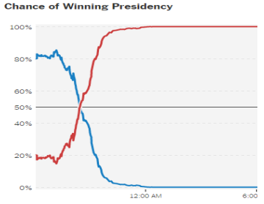
forecasting
SJIET
ELAVUR
Forecasting is the process of making predictions of the future based on past and present data!

Slide 3
forecasting
SJIET
ELAVUR
Coming up with predictions is important.
It is also very hard since none has the correct model of the world.
Explaining a particular kind of prediction is equally important, since you can make a more compelling case out of it.

Slide 4
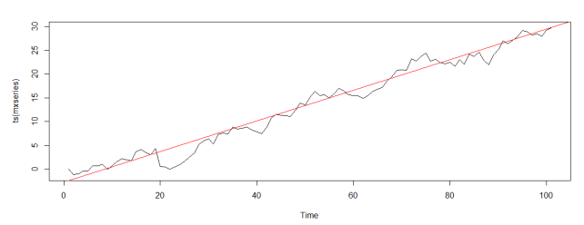
Some Key Concepts
SJIET
ELAVUR
Trend
Trend is component of time series that represents variations of ow frequency (usually with period longer than 8 years).
Source: www.oraylis.de/blog/trend-in-times-series-analysis

Slide 5
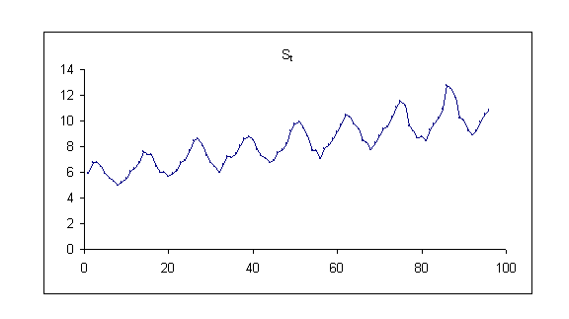
Some Key Concepts
SJIET
ELAVUR
Seasonality
Seasonality is component of time series that represents intra year fluctuations. More or less stable year after year.
Source: www.epixanalytics.com/modelassist/AtRisk/Model_Assist.htm#Time_series/Seasonal_time_series.htm

Slide 6
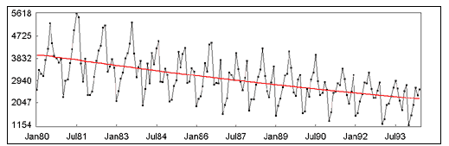
Some Key Concepts
SJIET
ELAVUR
Trend + Seasonality
Source: http://www.gistatgroup.com/cat/examples/ex_1_4.html

Slide 7
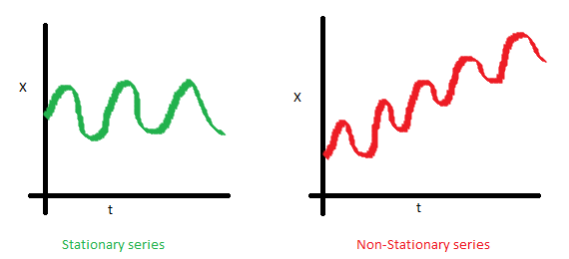
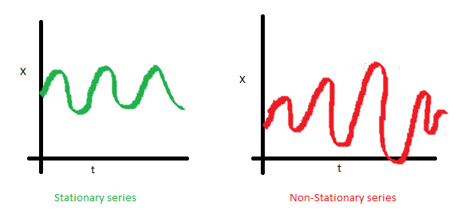
Some Key Concepts
SJIET
ELAVUR
Stationary Series
Constant Mean
Constant Variance
Why do we care about ‘Stationarity’ in Time Series Forecasting?

Slide 8
Data
SJIET
ELAVUR
The Standard & Poor's 500, often abbreviated as the S&P 500, or just the S&P, is an American stock market index based on the market capitalizations of 500 large companies having common stock listed on the NYSE or NASDAQ.
S&P 500 is a good representative of US stock market as well as US economy.
Stock Prices from January, 1995 to March 2018 are used for forecasting.

Slide 9
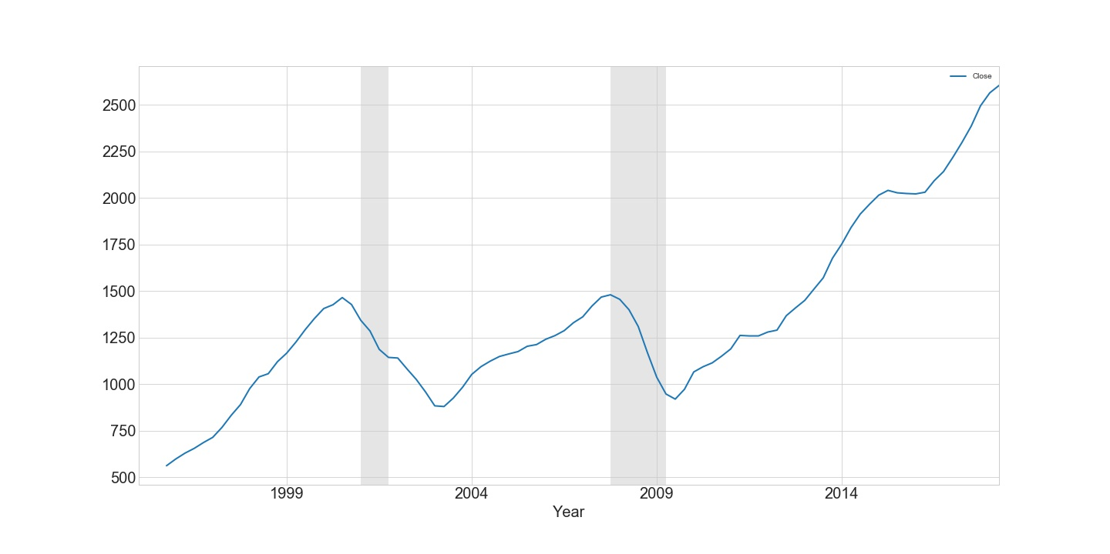
Exploratory Data Analysis
SJIET
ELAVUR
Trend

Slide 10
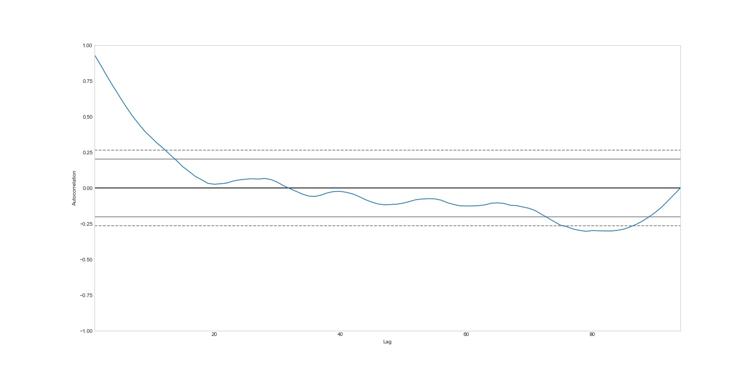
Exploratory Data Analysis
SJIET
ELAVUR
Auto-Correlation

Slide 11
Modeling
SJIET
ELAVUR
ARIMA
Stands for Autoregressive Integrated Moving Average
AR (Autoregressive model):
The autoregressive model specifies that the output variable depends linearly on its own previous values
AR(p) Y_{t} = β₀ + β₁Y_{t-1} + β₂Y_{t-2} + ... + β_{p}Y_{t-p} + e_{t}

Slide 12
Modeling
SJIET
ELAVUR
MA (Moving Average):
Moving average model is a common approach for modeling univariate time series. It specifies that the output variable depends linearly on the current and various past values.
MA (q) Y_{t} = µ + e_{t} + θ₁e_{t-1} + θ₂e_{t-2} + ... + θ_{q} e_{t-q}
* ARIMA models are generally denoted ARIMA(p,d,q) where parameters p, d, and q are non-negative integers, p is the order (number of time lags) of the autoregressive model, d is the degree of differencing (the number of times the data have had past values subtracted), and q is the order of the moving average model.

Slide 13
Modeling
SJIET
ELAVUR
RNN– Recurrent Neural Networks
What is RNN ?
Why are we using RNN for time series ?
Why not regular Neural Nets?

Slide 14
Modeling
SJIET
ELAVUR
Context
Simple multi-layered neural networks classifiers – When given a certain input, tag the input as belonging to one of the many classes.
https://www.pyimagesearch.com/2016/09/26/a-simple-neural-network-with-python-and-keras/

Slide 15
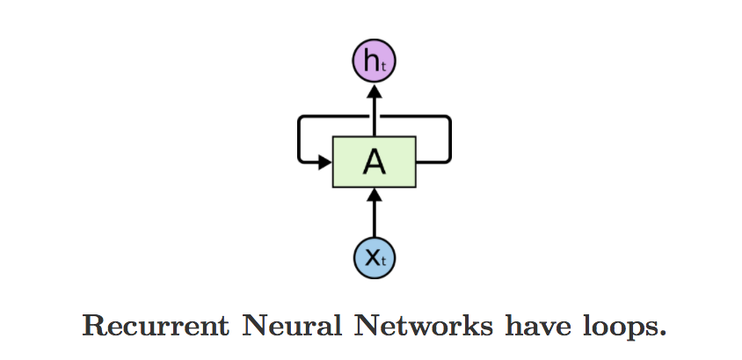
Modeling
SJIET
ELAVUR
RNN
As the RNN traverses the input sequence, output for every input also becomes a part of the input for the next item of the sequence.
https://iamtrask.github.io/2015/11/15/anyone-can-code-lstm/

Slide 16
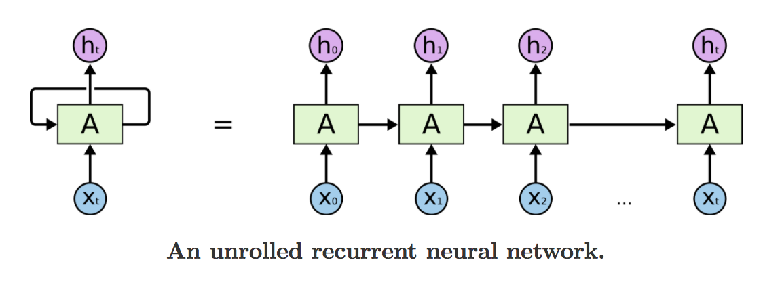
Modeling
SJIET
ELAVUR
RNN
https://iamtrask.github.io/2015/11/15/anyone-can-code-lstm/

Slide 17
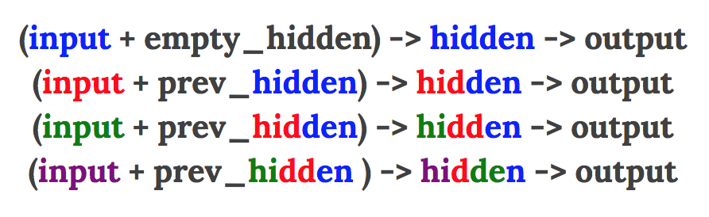
Modeling
SJIET
ELAVUR
RNN:-
Lets see which one works better or which one has better memory:
1) Hidden Layer Re-occurance
https://iamtrask.github.io/2015/11/15/anyone-can-code-lstm/

Slide 18
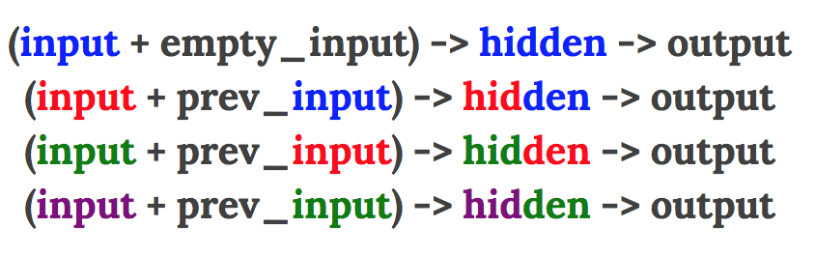
Modeling
SJIET
ELAVUR
RNN
2) Input layer re-occurance
https://iamtrask.github.io/2015/11/15/anyone-can-code-lstm/

Slide 19
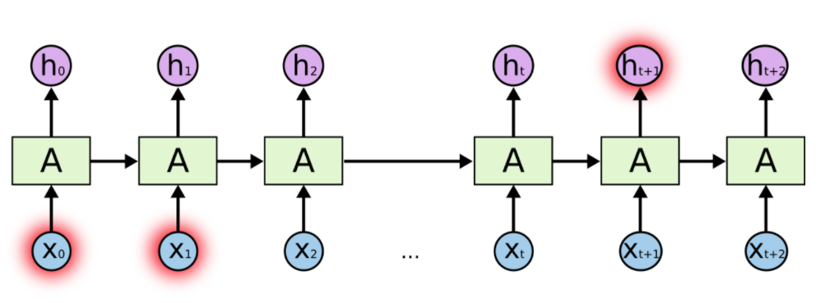
Modeling
SJIET
ELAVUR
Memory of RNN:

Slide 20
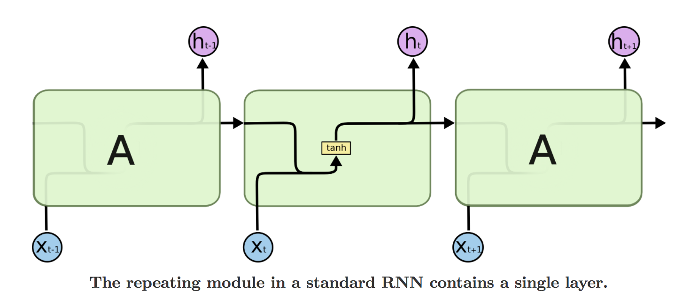
Modeling
SJIET
ELAVUR
Hidden layer of RNN:

Slide 21
Modeling
SJIET
ELAVUR
RNN with LSTM:
Long Short Term Memory is a RNN architecture which addresses the problem of training over long sequences and retaining memory.
A simple recurrent network suffers from a fundamental problem of not being able to capture long-term dependencies in a sequence.

Slide 22
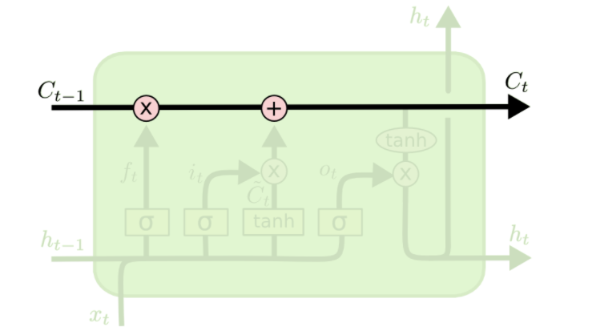
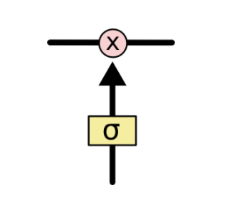
Modeling
SJIET
ELAVUR
Hidden layer of RNN with LSTM cell:
LSTM = Long short term memory

Slide 23
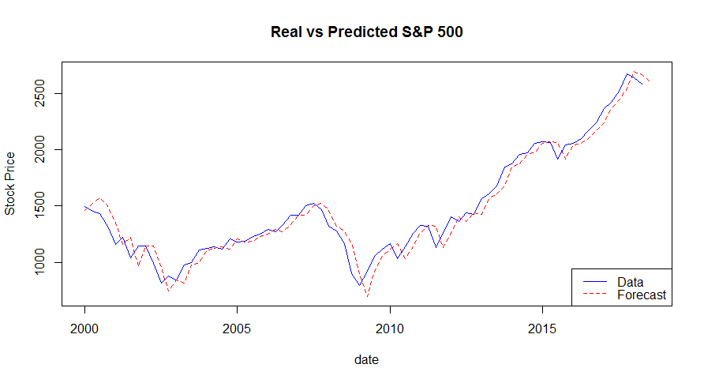
Prediction & Comparison
SJIET
ELAVUR
ARIMA

Slide 24

SJIET
ELAVUR

